Slide 1

ONLINE LAB DEADSTOCK MANAGEMENT
GROUP MEMBERS
1. Pooja Sharma (20104090)
2. Adarsh Singh (20104080)
3. Nainisha Sharma (20104042)
4. Aditya Waingade (20104099)
Project Guide: Prof. Apeksha Mohite

Slide 2
Contents
Introduction
Objectives
Scope
Features / Functionality
Project Outcomes
Technology Stack
Block Diagram
Implemented Page in GUI
Conclusion
Reference

Slide 3
1. Introduction
Essential function of Online Lab Deadstock Management system is viewing the recorded data, deleting the unwanted data, searching for date and modifying the data as the admin want.
Problem Identified :
Data records of particular lab’s deadstock was not easily stored and accessed.
Solution Proposed :
Data Base is designed so that it is easy to store and access information about specified lab’s deadstock.

Slide 4
2. Objectives
To create user friendly environment for management of labs deadstock element in database.
To prevent the loss of data by storing it in secure manner.
To maintain the record of deleted and updated data.
To get the total count of resourses present in all Lab.
To reduce the manual work to certain extent.

Slide 5
3. Scope
Our project aims at deadstock management, i.e. we have tried to computerize various processes of Deadstock Management System.
In computer system, it is not necessary to create the manifest but we can directly print it, which saves our time.
To assist the staff in capturing the effort spent on their respective working areas.
Our project can be used not only for lab deadstock management but also in other sectors.
Can be applied for different types of warehouses.
Can be applied in retailing sector.
Can be useful for chemist/drug shop managers.

Slide 6
4. Feature /Functionality
Laboratory deadstock elements tracking will be achieved.
The Data will be stored in organized manner and will be easily accessed with required credentials.
The Deleted and updated data can be accessed by user when required.
The user can easily track the required data through the search option.
No physical resourses will be required to store the data.
Through various error prevention method major manual errors can be avoided to achive authenticity of data.

Slide 7
5. Outcome of Project
Main outcome of our project will achive is organized storage of importand deadstock data.
Only the Signed Up user can add or modify the given.
Availability of search feature will enable the user to access the required data immediately instead of manual searching.
The user can also maintain and access the record of deleted and updated data from the database.
The user can also track the total recourses of every Lab through the overall search.

Slide 8
6. Technology Stack
Front End: - Python, PyCharm.
Back End: - MySQL Workbench , SSMS.

Slide 9
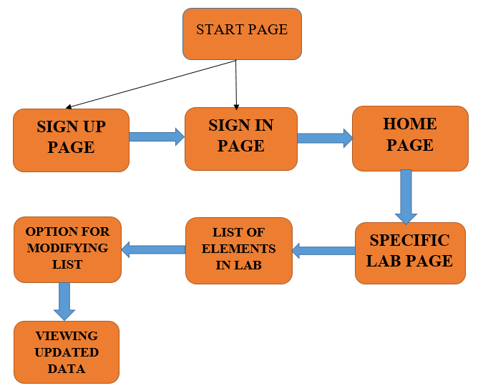
7.Block Diagram

Slide 10
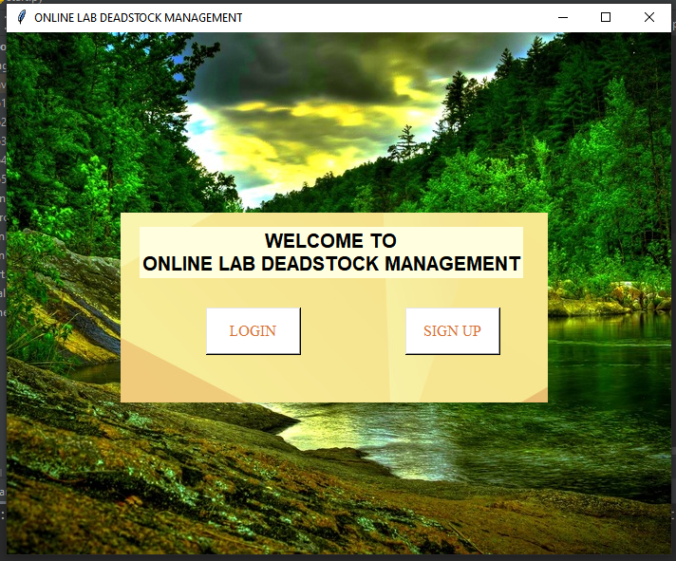
GUI of Start Page

Slide 11
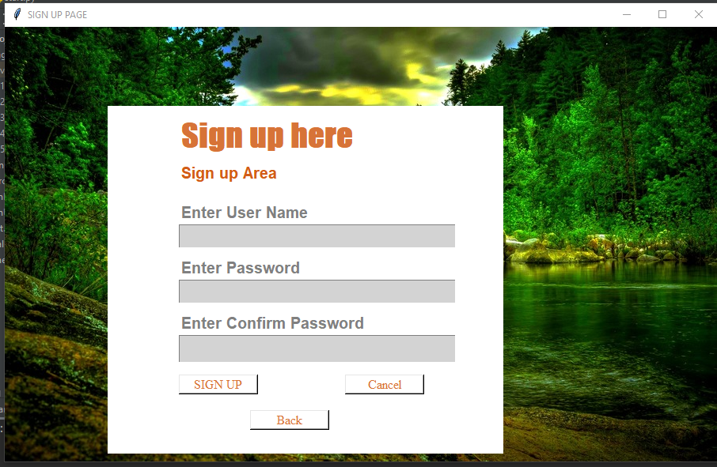
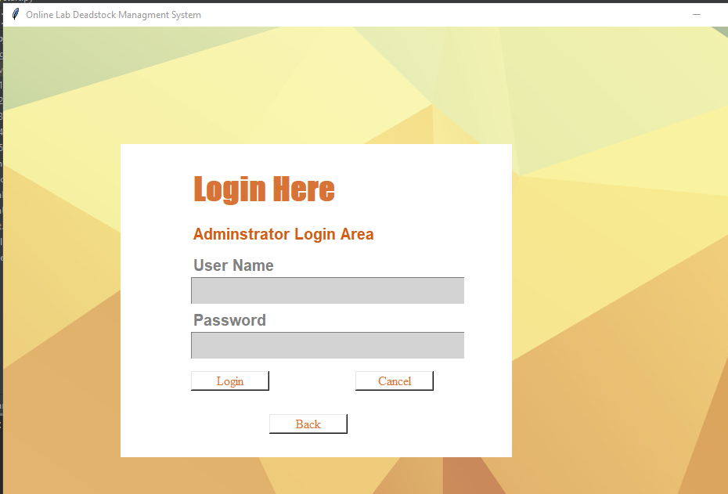
GUI of Signup and SignIn Page

Slide 12
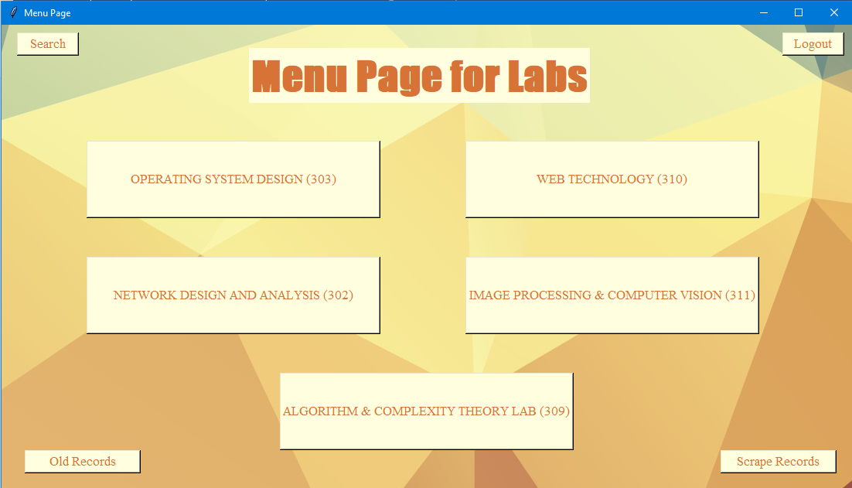
GUI of Menu Page

Slide 13
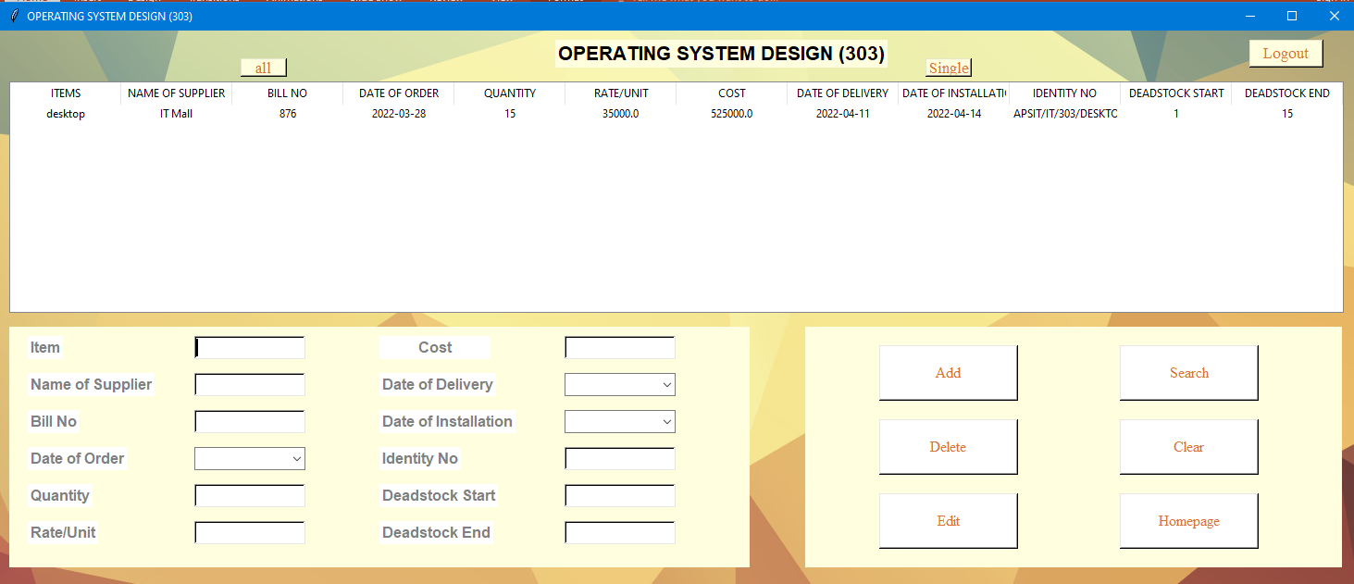
GUI of Lab Page

Slide 14
8. Conclusion
Thus we have created our system in such a way that the admin can manage the data records easily and efficiently.
The system is created in such a way so that it can satisfy all the requirement of the labs present in colleges.
The admin will be able to manage the records in less time as compared to before when the work was done manually.

Slide 15
9. Reference
International Journal of Advanced Research in Computer and Communication Engineering IJARCCE 10.pdf Vol. 7, Issue 2, February 2018
https://www.theijes.com/papers/v4-i5/Version-2/C045209017.pd
https://www.youtube.com/watch?v=6oSWzvJMbBQ
https://www.geeksforgeeks.org/inventory-management-with-json-in-python

Slide 16
Thank You....!!

